Slide 1

PROBLEM STATEMENT
Create a responsive Web Application that buys and sells movies on rent.

Slide 2
Description of the website
User can see variety of movies .
Admin can add or remove any user.
User can use Search bar to know about any movies and can also watch trailer of that movie.
User can watch teasers and trailers of the movie for free.
User can know details about the movie like rating , director , runtime , price and age rating etc.
User can also signup in our website .
In login page user can login and signup by giving their username and password .
User can buy and rent any movie through payment gateway ..

Slide 3





TEAM MEMBERS
Suman Jaiswal
Sushil yadav
TEAM MENTOR
TEAM LEADER
Anurag das
Amber deshbhratar
Vishesh garg

Slide 4






HTML5
DJANGO
BOOTSTRAP
JAVASCRIPT
PYTHON
CSS
TECHNOLOGIES USED

Slide 5
Reason For Using Particular Tool
We have used Django for our backend because Django is considered the best Python web framework, and it's great for creating database-driven websites.
It can also work with any client-side framework and can deliver content in any format such as HTML, JSON, XML, etc.
All the codes of the Django framework are written in Python, which runs on many platforms, such as Linux, Windows, and Mac OS. Django web development is more stable
We have used IMDB API KEY as IMDb API helps to query for all information about films, actors, characters, etc.…Also we can fetch film data and search results from IMDB.

Slide 6

Time line
Started coding of Backend part
June 26th
Submission of proposal
June 29th
Approval of Proposal and assignment of mentor
June 30th
Start coding of Frontend part
19th July
Mid Evaluation
20th July
11th August
13th August
Report Submission
Web Hosting

Slide 7

FLOW CHART
API
SERVER
HTML,CSS
JSON
MOVIE WESITE
SEARCH
PAYMENT ₹
Fetch movies from YouTube
RAZORPAY
Contact Us
Second page

Slide 8
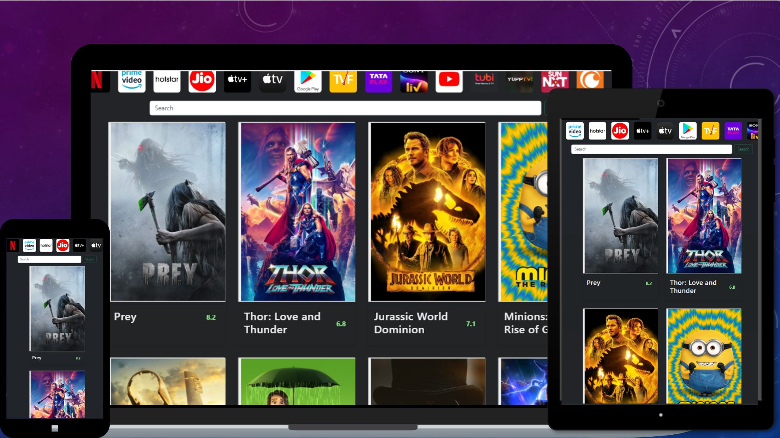
Responsiveness of website

Slide 9
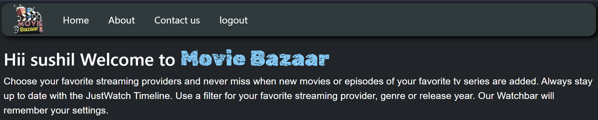
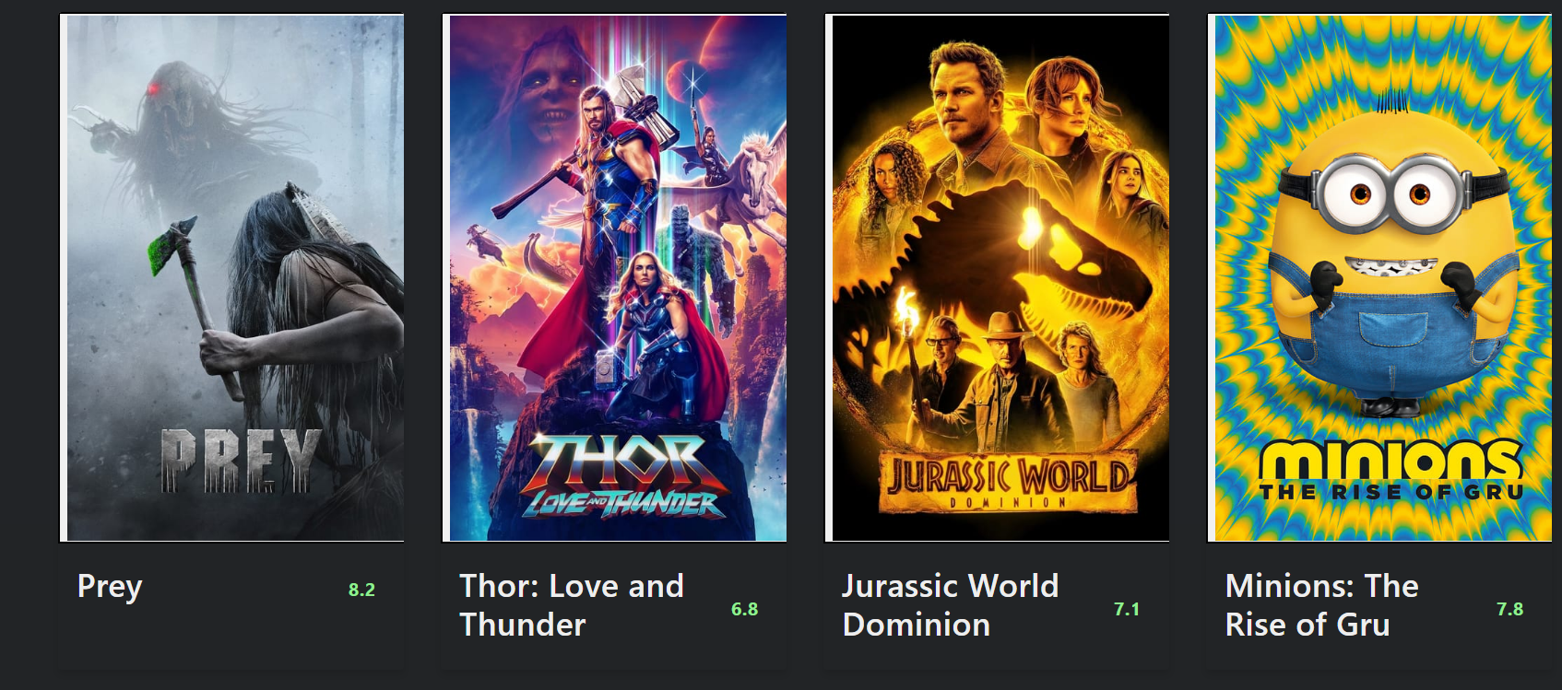
Home PAGE
Link Of Website
http://moviebazaar.pythonanywhere.com/
Navigation Bar
Search Bar
Preview Of Movies

Slide 10
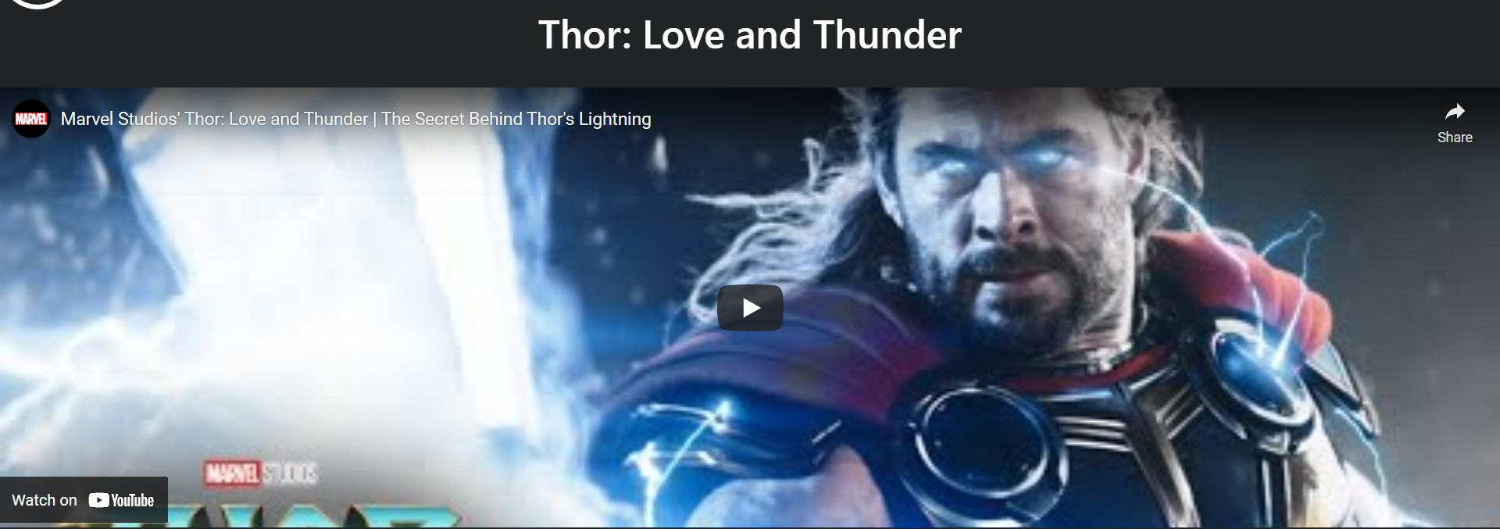
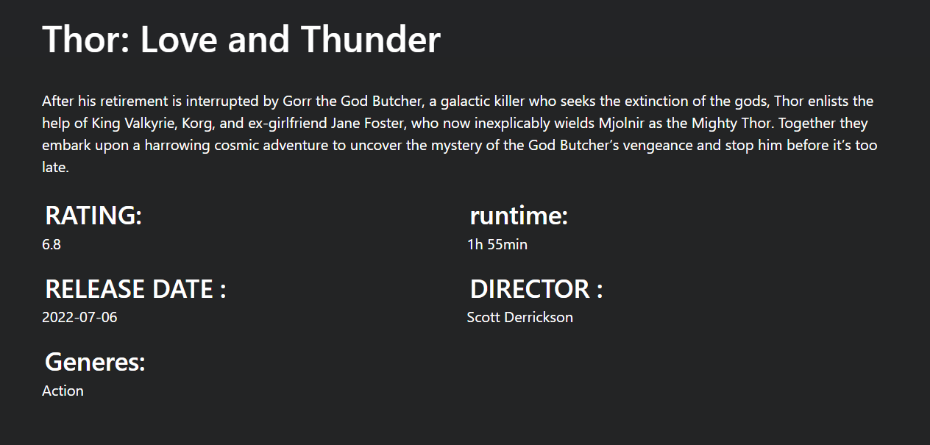
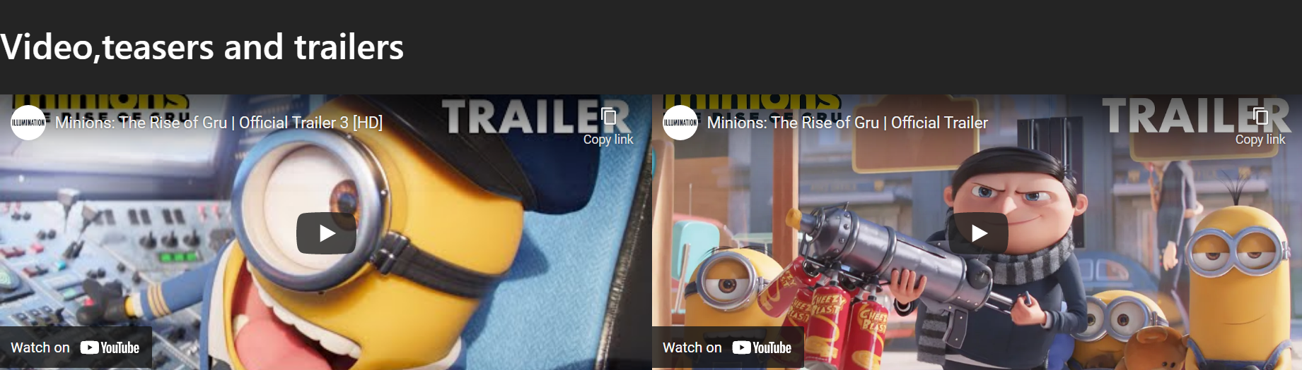
Landing Page of a MOVIE
User can watch the trailer of the movie
User can know details about the movie like description rating , runtime , release date, director and genres etc.
User can also watch other clips like of that movie

Slide 11
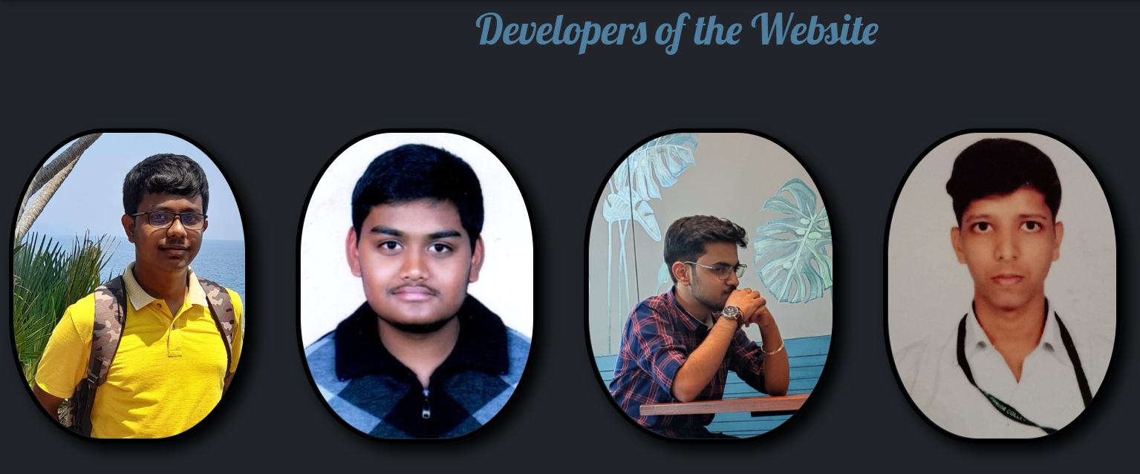
ABOUT PAGE
Link of About Page
http://moviebazaar1.pythonanywhere.com/about
Developers Of The Website
User can get information about the developers by moving cursor through the image of the developer.

Slide 12
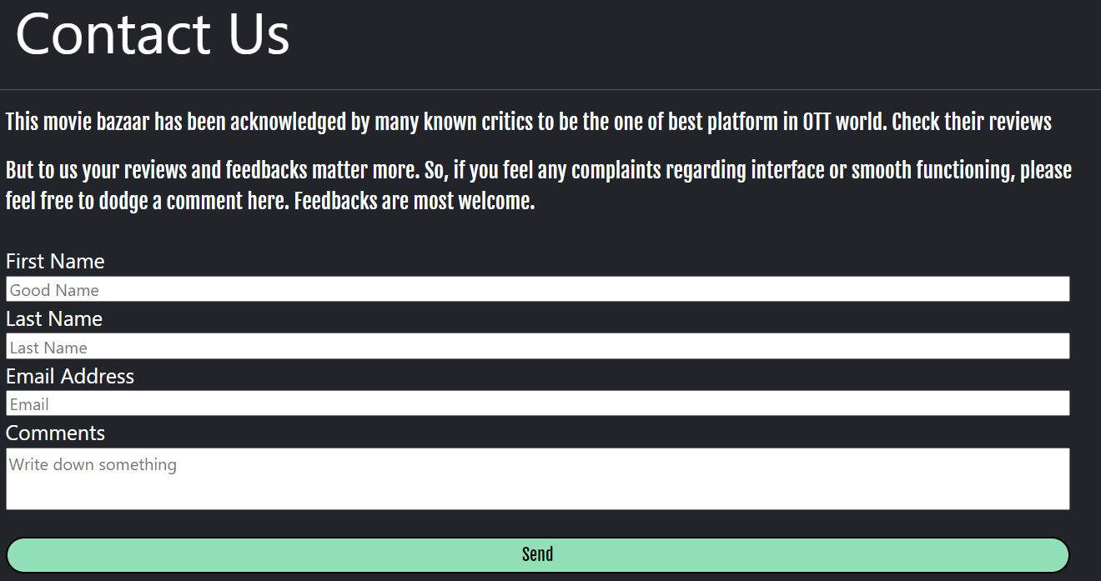
Contact Us Page
Link of Contact Us Page
http://moviebazaar1.pythonanywhere.com/contactus
User can make comment by filling necessary details

Slide 13
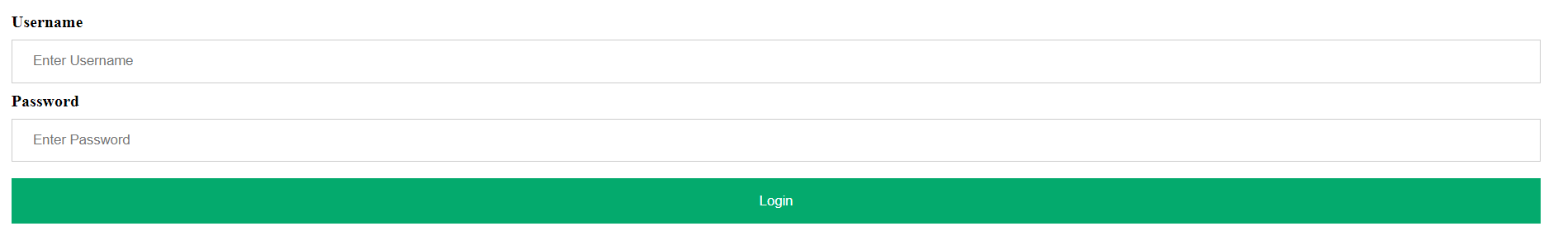
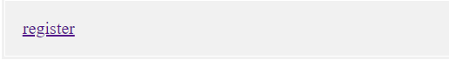
Login Or Sign Up Page
http://moviebazaar1.pythonanywhere.com/login
Link of Login Or Sign-Up Page
Existing users can login by filling their Username and Password
New users can register themselves

Slide 14
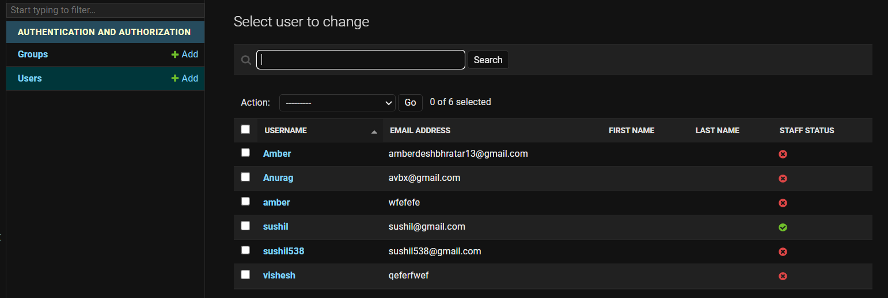
Admin interface
Admin can access the database of the users
https://moviebazaar1.pythonanywhere.com/admin/
Link of the Admin page

Slide 15
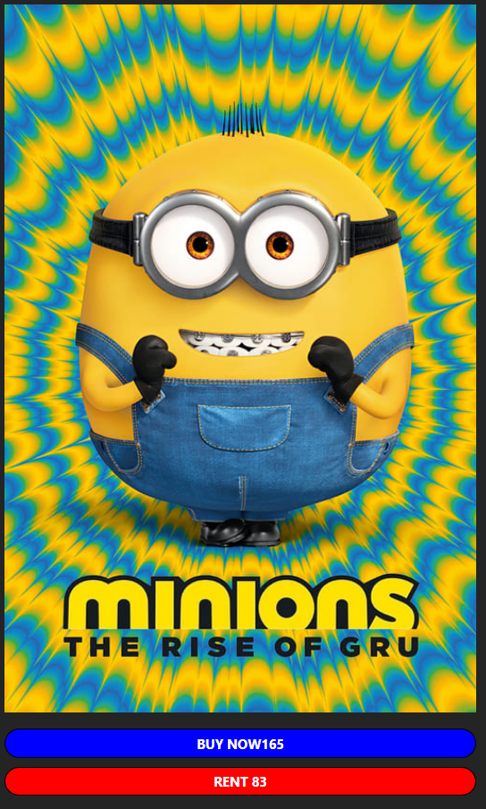
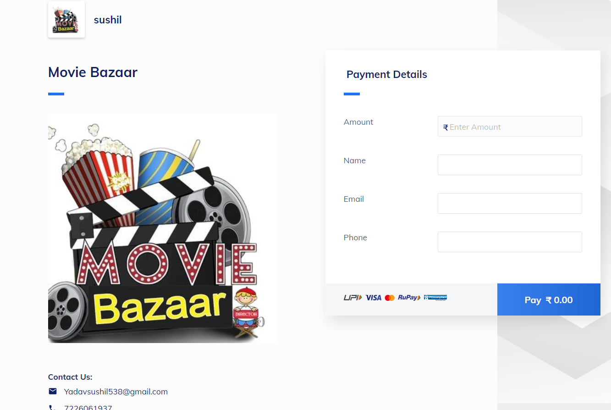
Payment Gateway
User can make payment to but or rent movies on movie landing page
When user clicks on buy or rent button it opens payment gate way

Slide 16
THANK YOU

